Slide 1
Software Project Management

Slide 2
Project Management - INTRODUCTION
A project is a temporary attempt undertaken to create a unique product or service. A project in business and science is a collaborative enterprise, frequently involving research or design, that is carefully planned to achieve a particular aim
Project Management Institute (PMI), has defined Project Management as “the application of knowledge, skills, tools and techniques to a broad range of activities in order to meet the requirements of a particular project.”
The ability to deliver projects on schedule, on budget, and aligned with business goals is key to gaining an edge in today’s highly competitive global business environment. This is where project managers come in.
Notes:
The word “temporary” means projects must have a defined beginning and end. This means every project must include a timeline, scope and resources. The fact that it is temporary with a beginning and an end also means that it is not part of ongoing operations. This brings us to the second point...
The purpose of a project must be “to create a unique product, service, or result.” This means a project will be started in order to accomplish a specific goal that is typically outside the realm of the typical day-to-day business operation. This means, the project team might include people who don’t usually work together, and require resources that are typically outside the scope of day-to-day operations

Slide 3
What is a Project?
A Project is a series of activities and tasks that:
Have a specific tasks and activities to be completed with certain objectives.
Have a defined start and end dates
Have funding limits (if applicable)
Consume Resources

Slide 4
Typical Project Structure
Project
Definition
Project
Monitoring
Project
Planning
Project
Implementation
Project
Evaluation
Project
Adjustment

Slide 5
Project Life Cycle
Resources and Effort
Phase 1
Phase 2
Phase 3
Phase 4
Phase 5
Conceptual
Design
Advanced
Development
Detailed
Design
Project
Implementation
Project
Termination
Goals
Scope
Baseline
Requirements
Feasibility
Desirability
Plan
Budget
Schedule
Management
Commitment
Define
Responsibility
Team
Organization
Structure
Detailed Plan
Kickoff
Manage
Measure
Control
Update and
Modify Plan
Problem Solve
Closeout
Document
Suggest
Improvements
Reassign
Dissolve Project
Team

Slide 6
Successful Projects
A successful project is one which achieves the following objectives:
Completed On Time
Completed Within Cost
Meets Performance Criteria
Minimum Disruption of the Main Work of the Organization
Effective Utilization of Available Resources

Slide 7
The Triple Play of Project Management
Constraints
Time
Cost
Performance

Slide 8
Reasons for Project Failures
Major reasons for project runaways
unclear objectives
bad planning
no project management methodology
new technology
insufficient staff
All of these relate to project management
Effective project management is key to successfully executing a project

Slide 9
Activities of project management
Project management primarily focuses on planning, managing and organizing the available resources
Major activities of project management are:
Planning Project and Tracking Project
Estimation of cost
Estimation of Schedule
Managing Human Resource

Slide 10
Planning /tracking Project
Plan how the project will be executed, (ie. the process to be followed)
Process will decide the tasks, their ordering, milestones
Plan the team and human resources
Plan the activities, deliverables and schedule
Tracking project means:
How long will it take to develop the system?
How much will it cost to develop the system?
Are we working according to the schedule and planned activities?
Work Breakdown Structure (WBS) is an important Techniques for planning activities and tasks

Slide 11
Work Breakdown Structure (WBS)
Dividing complex projects to simpler and manageable tasks is the process identified as Work Breakdown Structure (WBS).
Usually, the project managers use this method for simplifying the project execution.
In WBS, much larger tasks are broken down to manageable chunks of work. These chunks can be easily supervised and estimated.
These smaller chunks and tasks are distributed among team according to their skill and expertise.

Slide 12
Construction of WBS
Identifying the main deliverables of a project is the starting point for deriving a work breakdown structure.
Once this step is completed, the subject matter experts start breaking down the high-level tasks into smaller chunks of work.
In the process of breaking down the tasks, one can break them down into different levels of detail. One can detail a high-level task into ten sub-tasks while another can detail the same high-level task into 20 sub-tasks.
Therefore, there is no hard and fast rule on how you should breakdown a task in WBS.
We can decompose System of tasks in multiple ways
1- Deliverable Based
2- Phase Based

Slide 13
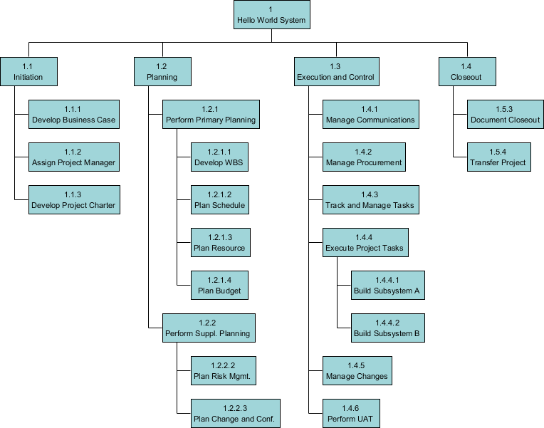
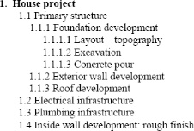
Forms of WBS
Tree structure
List / Tables

Slide 14
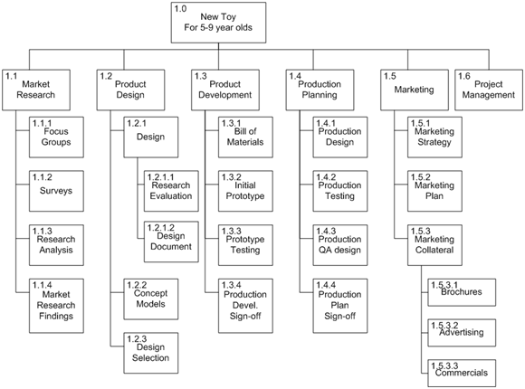
Examples

Slide 15
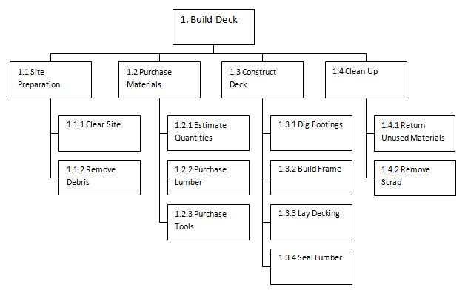
Examples

Slide 16
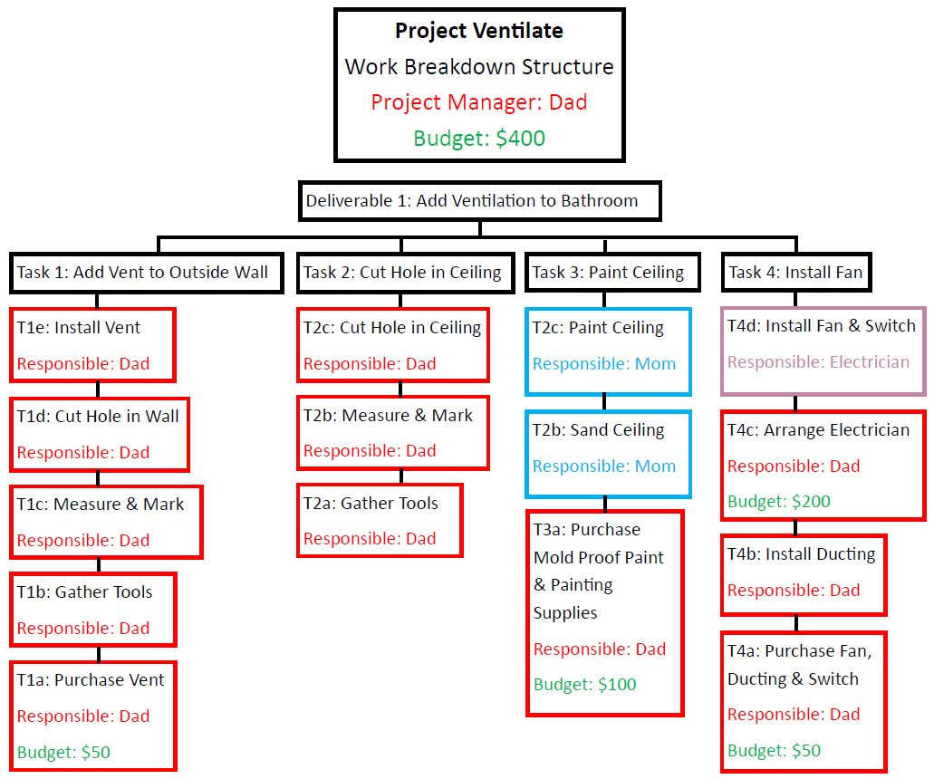
Examples

Slide 17
Estimation of Schedule
Divide the project into smaller activities or tasks and estimates the duration that each task or activity will take.
Technique for schedule estimation
Critical Path Method (CPM)
Gantt chart

Slide 18
Example: Steps and activities to build a house
Building the house
Step 1: Prepare the site
Activity 1.1: Survey the land
Activity 1.2: Request permits
Activity 1.3: Excavate for the foundation
Activity 1.4: Buy materials
 | Step 2: Building the exterior
Activity 2.1: Lay the foundation
Activity 2.2: Build the outside walls
Activity 2.3: Install exterior plumbing
Activity 2.4: Exterior electrical work
Activity 2.5: Exterior siding
Activity 2.6: Paint the exterior
Activity 2.7: Install doors and fixtures
Activity 2.8: Install roof
 |  | Step 3: Finishing the interior
Activity 3.1: Install the interior plumbing
Activity 3.2: Install interior electrical work
Activity 3.3: Install wallboard
Activity 3.4: Paint the interior
Activity 3.5: Install floor covering
Activity 3.6: Install doors and fixtures

Slide 19
Milestones
1.1. Survey complete
1.2. Permits issued
1.3. Excavation complete
1.4. Materials on hand
2.1. Foundation laid
2.2. Outside walls complete
2.3. Exterior plumbing complete
2.4. Exterior electrical work complete
2.5. Exterior siding complete
2.6. Exterior painting complete
2.7. Doors and fixtures mounted
2.8. Roof complete
3.1. Interior plumbing complete
3.2. Interior electrical work complete
3.3. Wallboard in place
3.4. Interior painting complete
3.5. Floor covering laid
3.6. Doors and fixtures mounted

Slide 20
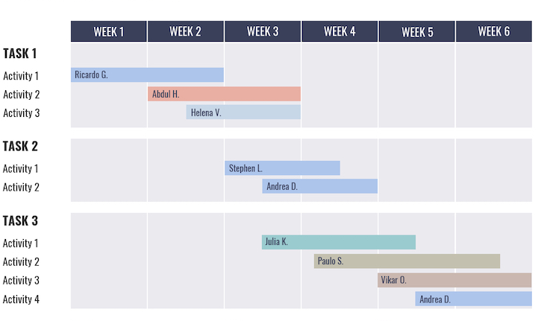
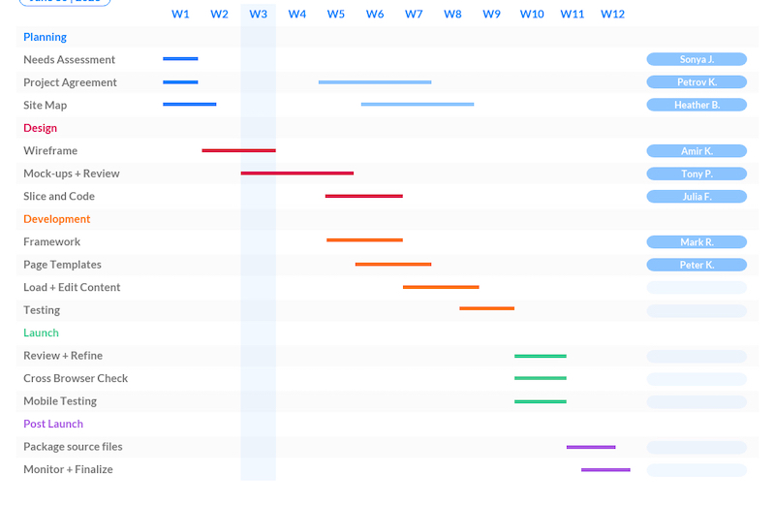
GANTT CHART

Slide 21
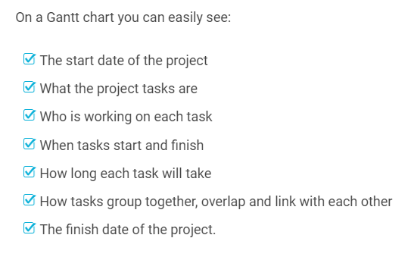
Gantt Chart
Purpose: Your team members are constantly sending you Slack messages asking you to remind them of deadlines.
Your client won’t stop emailing you, asking who’s responsible for what part of the project, and when.

Slide 22
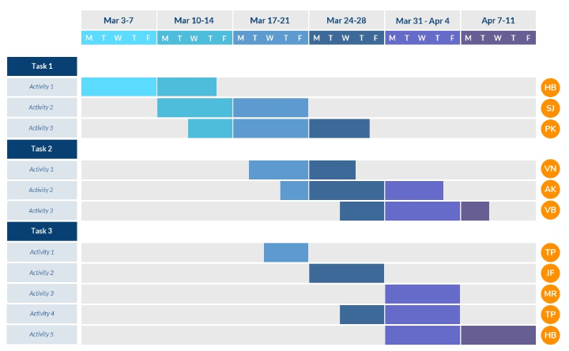
GANTT CHART
The top of the chart shows the time frame and the left side of the chart lists the project activities
Notes:
For example, in the daily project status Gantt chart above, Activity 1 (Task 1) will take place from March 3 to 7 and then March 10 to 13. The due date is Thursday of that week. Each week is color coded.

Slide 23
In short, a Gantt chart shows:
What tasks need to be done to complete the project
When these tasks need to be done
It lets you set the order in which tasks should be completed.
A Gantt chart is the perfect way to manage tasks between multiple teams as all the information is in one place, in a crystal-clear format.

Slide 24
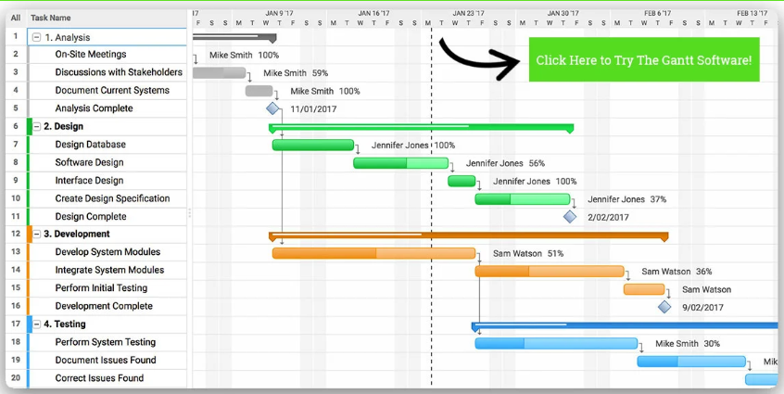
GANTT CHART

